Slide 1

Statistics For Data Science
Explanation and re-implementation of [Guoping Zeng & Edward Zeng (2019) On the three-way equivalence of AUC in credit scoring with tied scores]
Artesi simone, incerti alessandro and la piccirella alberto

Slide 2
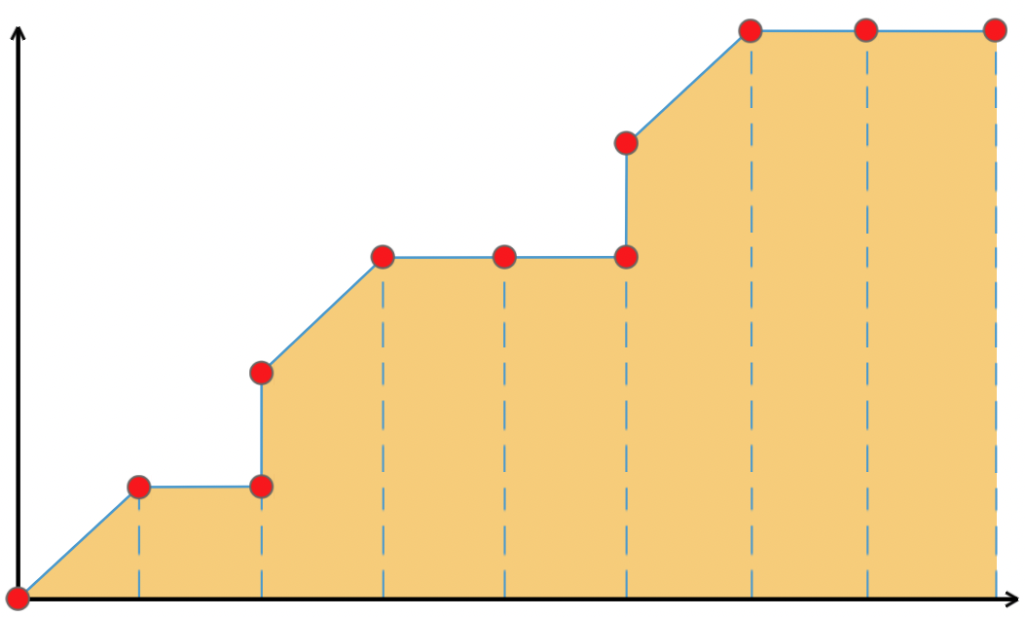
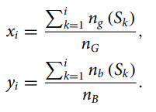
PREMISES
classifier
Roc e auc
INPUT
0 < AUC < 1
MODELLO DI CLASSIFICAZIONE
OUTPUT
Status
0,1 0 1 0,1 0 0 1 0,1 0 0
Score
150 180 190 200 205 230 250 260 280 300

Slide 3




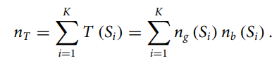
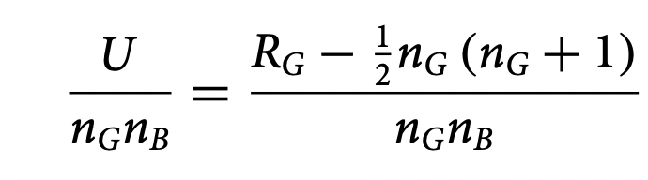
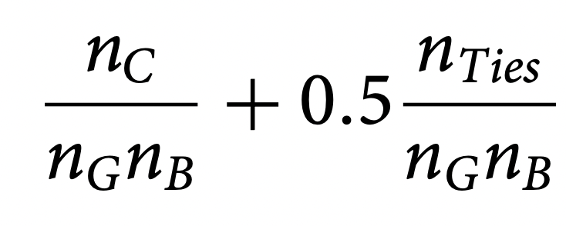
Three ways to calculate AUC:
Wilcoxon Rank-sum Statistic
Geometric
Adjusted percent of concordant pairs
AUC =
AUC =
Notes:
U ti da un valore molto vicino all’AUC ma non tiene conto delle tied pairs

Slide 4
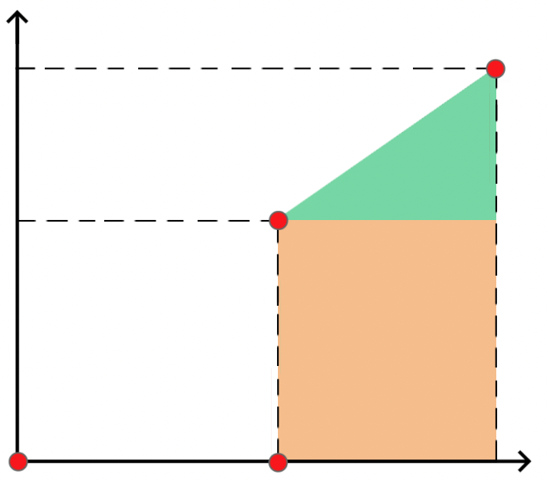


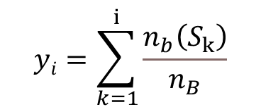



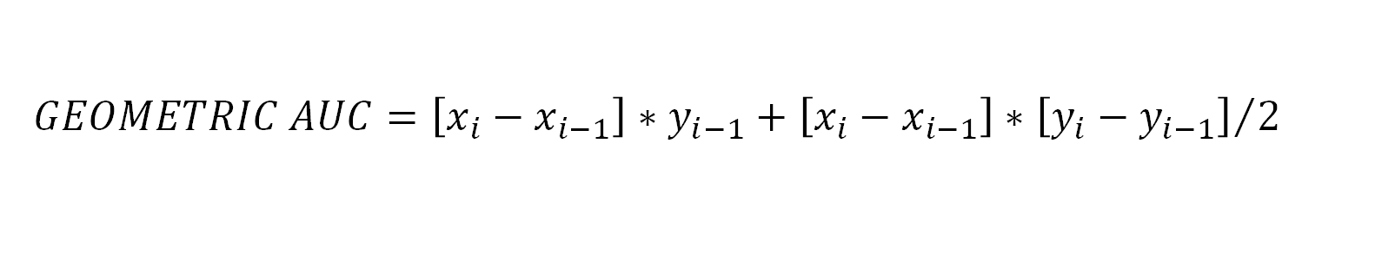



The geometric formula for a generic portion of AUC
$$xi=\sum_{k=1}^{i}{\frac{n_{g}\left(S_{k}\right)}{n_{G}}}$$
$$s_{i}$$
$$y_{i}$$
$$yi=\sum_{k=1}^{i}{\frac{n_{b}\left(S_{k}\right)}{n_{B}}}$$
$$s_{\left(i−1\right)}$$
$$y_{i−1}$$
Note:
$$x_{i−1}$$
$$x_{i}$$
RETTAGLE AREA​
TRIANGLE AREA​
$$GEOMETRIC AUC=\left[x_{i}−x_{i−1}\right]∗y_{i−1}+\left[x_{i}−x_{i−1}\right]∗{\left[y_{i}−y_{i−1}\right]}/2$$
Notes:
Csi = yi-1

Slide 5


Problems and Objectives
This equivalence was first presented in (Hanley and McNeil, 1982), but:
Without considering tied scores.
Without providing an analytical proof.
The paper will present aims to fill this two important gaps
Theorem 1) Geometric AUC equals adjusted percent of the concordant pairs
Theorem 2) The adjusted percent of the concordant pairs equals the adjusted
Wilcoxon Rank Sum Statistic
Geometric
Notes:
Letteratura successiva ha citato molte volte l’opera senza mai colmare le due lacune.

Slide 6
INDEX THEOREM 1
Division of S₁ in three cases:
1.1 S₁ has both bads and goods
1.2 S₁ has only goods
1.2.1 S_{i} has at least one good
1.2.2 S_{i} has only bads
1.2.2.1 S_{j} has at least one bad
1.2.2.2 S_{j} does not have a bad
1.3 S₁ has only bads
1.3.1 S_{i} has at least one bad
1.3.2 S_{i} does not have a bad
2. Case following the next position after S_{i1} ∈ {1, j, i}
2.1 S_{l} has at least one bad
2.2 S_{l} does not have a bad
3. Case after 2. I start again from (x_{k}, y_{k}) which is the 1st pt with AUC different from 0. Same as step 2
4. Conclusion
Aim of the project:
We will prove for each of the following case the AUC formula, beginning always with the definition of the Geometric AUC
The index shows that the paper covers all the cases

Slide 7



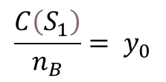
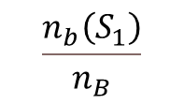
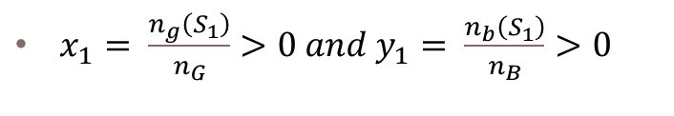
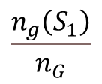

1.1 (Both G and B)
$x_{1}= \frac{n_{g}\left(S_{1}\right)}{n_{G}}>0 and y_{1}= \frac{n_{b}\left(S_{1}\right)}{n_{B}}>0$
RETTAGLE AREA
TRIANGLE AREA
$$s_{1}$$
$$\frac{n_{b}\left(S_{1}\right)}{n_{B}}$$
$GEOMETRIC AUC=\frac{1}{2}x_{1}y_{1}=[ \frac{n_{g}\left(S_{1}\right)}{n_{G}}∗ \frac{C(S_{1})}{n_{B}}$ ]
+ 0,5 $[ \frac{n_{g }(S_{1})}{n_{G}}$ * $\frac{n_{b }(S_{1})}{n_{B}} ]$
BASE
HEIGHT
BASE
HEIGHT
= 0
$$T\left(S_{i}\right)= n_{g}\left(S_{i}\right)∗ n_{b}\left(S_{i}\right)$$
$$\frac{C\left(S_{1}\right)}{n_{B}}= y_{0}$$
$$\frac{n_{g}\left(S_{1}\right)}{n_{G}}$$
$GEOMETRIC AUC=[ \frac{n_{g}\left(S_{1}\right)}{n_{G}}\frac{C(S_{1})}{n_{B}}$ ] + 0,5 $\frac{{T(S}_{1})}{n_{G}n_{B}}$

Slide 8


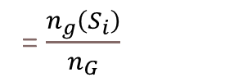




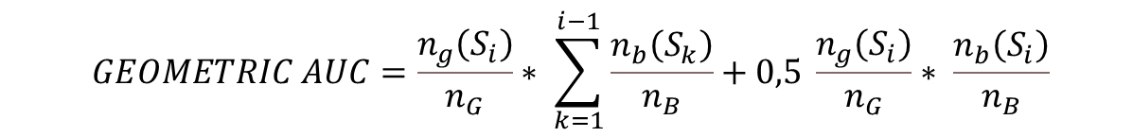
1.2 (Only goods)
1.2.1
$$\left(x_{i} , y_{i}\right)$$
Only goods cases correspond to S1
$x_{1}>0 and y_{1}=0$
= $\frac{n_{b}\left(S_{i}\right)}{n_{B}}$
Def) S_{i}
$$\left(x_{i−1},y_{i−1}\right)$$
$$\left(0,0\right)$$
$$\left(x_{1},y_{1}\right)$$
= $\frac{n_{g}\left(S_{i}\right)}{n_{G}}$
$$GEOMETRIC AUC=\frac{n_{g}\left(S_{i}\right)}{n_{G}}∗ \sum_{k=1}^{i−1}{\frac{n_{b}\left(S_{k}\right)}{n_{B}}+0,5 \frac{n_{g}\left(S_{i}\right)}{n_{G}}∗ \frac{n_{b}\left(S_{i}\right)}{n_{B}}}$$
2 Subcases:
1.2.1 S_{i} has at least 1 good
1.2.2 S_{i} has no good
$T\left(S_{i}\right)$ and $C\left(S_{i}\right)$ as before
$GEOMETRIC AUC=[ \frac{n_{g}\left(S_{1}\right)}{n_{G}}\frac{C(S_{1})}{n_{B}}$ ] + 0,5 $\frac{{T(S}_{1})}{n_{G}n_{B}}$

Slide 9



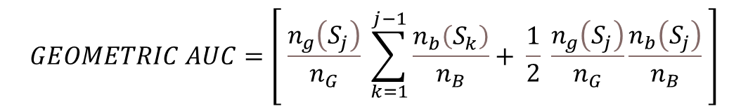



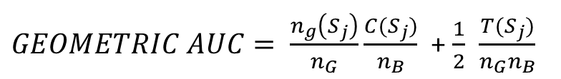





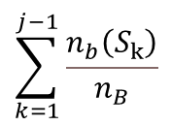
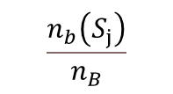


1.2.2 (Only bads)
$x_{i−1}= x_{i}$
RECTANGLE
TRIANGLE
Def S_{j} 2 Subcases:
$$GEOMETRIC AUC=\left[ \frac{n_{g}\left(S_{j}\right)}{n_{G}} \sum_{k=1}^{j−1}{\frac{n_{b}\left(S_{k}\right)}{n_{B}}+ \frac{1}{2}} \frac{n_{g}\left(S_{j}\right)}{n_{G}}\frac{n_{b}\left(S_{j}\right)}{n_{B}} \right]$$
1.2.2.1 S_{j} has at least one bad
1.2.2.2 S_{j} has no bads
1.2.2.2 S_{j} has no bads
$$\left(x_{j} , y_{j}\right)$$
$T\left(S_{i}\right)$ and $C\left(S_{i}\right)$ as before
$$\frac{n_{b}\left(S_{j}\right)}{n_{B}}$$
=
$$\sum_{k=1}^{j−1}{\frac{n_{b}\left(S_{k}\right)}{n_{B}}}$$
$$\left(x_{j−1} , y_{j−1}\right)$$
$$\left(x_{j} , y_{j}\right)$$
$$y_{j}− y_{j−1}$$
$GEOMETRIC AUC= \frac{n_{g}\left(S_{j}\right)}{n_{G}}\frac{C(S_{j})}{n_{B}}$ + $\frac{1}{2}$ $\frac{{T(S}_{j})}{n_{G}n_{B}}$
= $\frac{n_{b}\left(S_{j}\right)}{n_{B}}$ = 0
$$\left(x_{i} , y_{i}\right)$$
Analogously: 1.3 S₁ has only bads, so
S_{i} has at least one bad →
S_{i} has no bads →
$$x_{1}=0 and y_{1}>0$$
$$\left(x_{i−1} , y_{i−1}\right)$$
$$y_{i−1}> y_{i}$$
$$\left(0 , 0\right)$$
$$y_{i−1}= y_{i}$$
$$\frac{n_{g}\left(S_{j}\right)}{n_{G}}$$

Slide 10
And so on…
Step 2 → Case following the next position after ∈ {1, j, i}
Step 3 → iteration of the second case
Step 4 → final result:
Our exaple:
, with
Geometric
x | 0 | 0,125 | 0,25 | 0,25 | 0,375 | 0,5 | 0,625 | 0,625 | 0,75 | 0,875 | 1
y | 0 | 0,2 | 0,2 | 0,4 | 0,6 | 0,6 | 0,6 | 0,8 | 1 | 1 | 1

Slide 11
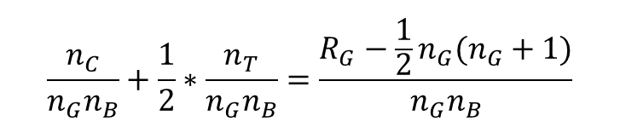
Proof Theorem 2
$$\frac{n_{C}}{n_{G}n_{B}}+\frac{1}{2}∗\frac{n_{T}}{n_{G}n_{B}}=\frac{R_{G}−\frac{1}{2}n_{G}(n_{G}+1)}{n_{G}n_{B}}$$
Theorem 2 )
Proof
Adjusted percent of concordant pairs
Wilcoxon
Rank-Sum Statistics
=
Label | G | G | G | B | B | G | G | B | G | B
Score | 100 | 120 | 130 | 140 | 150 | 150 | 150 | 150 | 160 | 200
i | 1 | 2 | 3 | X | X | 4 | 5 | X | 6 | X
Rank | 1 | 2 | 3 | 4 | 6,5 | 6,5 | 6,5 | 6,5 | 9 | 10
SOLUTION TO FIRST GAP:
Give the mean of the ranks to the tied scores
R(i) - i is the N of bads with score < S_{i}
If ith Good has no tied score
If ith good has a tied score
j = Good with S_{i}
k = Bad with S_{i}
m = records with core < S_{i}
l = Good with score < S_{i}
(m-l) is the n of bads with score < S_{i}

Slide 12








Proof Theorem 2
SCORE S_{i}
Rank of each status with score S_{i}

Slide 13
Thank you for your attention!

